Slide 1
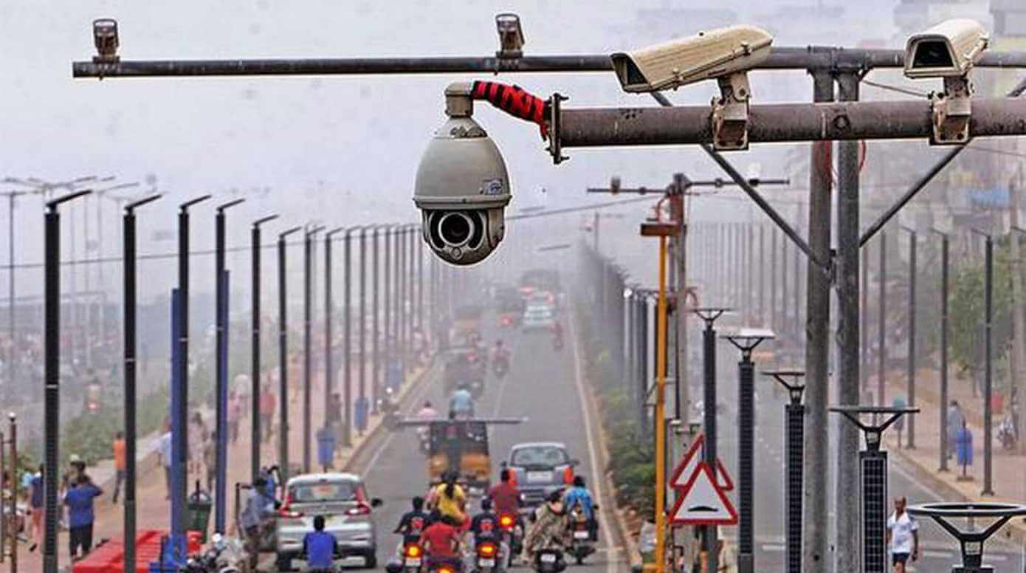
GP - 5
VioCam : Smart Camera for Traffic Violation Detection
101816022 - Aryan Tyagi
101816016 - Tushar Kumar Riyat
101803717 - Aditya Singh
Under the mentorship of
Dr. Seema Wazarkar

Slide 2
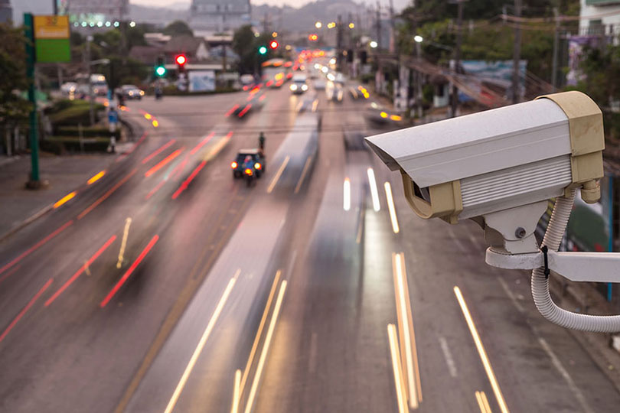
Background and Scope
To make an automatic camera system to detect and report traffic violations with the help of machine learning with additional features like traffic congestion control, automatic challan generation that can be easily used by any state government at any traffic junction

Slide 3
Objectives
Differentiate between types of vehicles
Train the model on Indian cars
Convert the previous model to single class model
Improve helmet detection

Slide 4
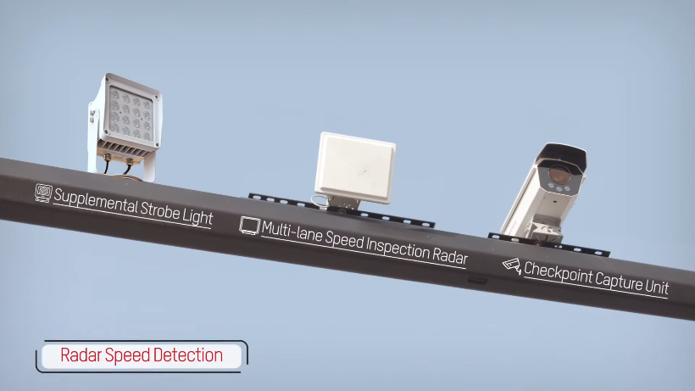
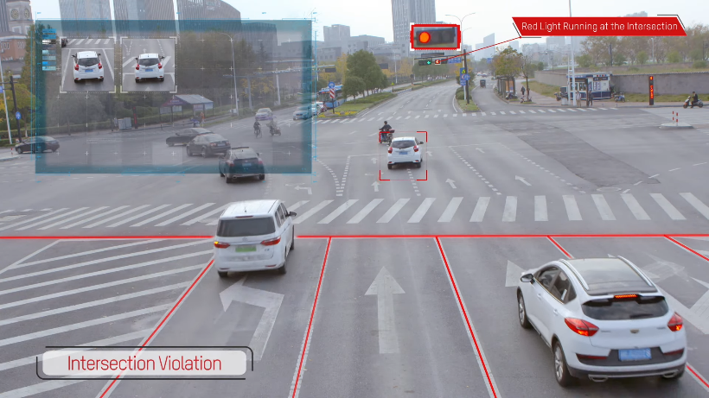
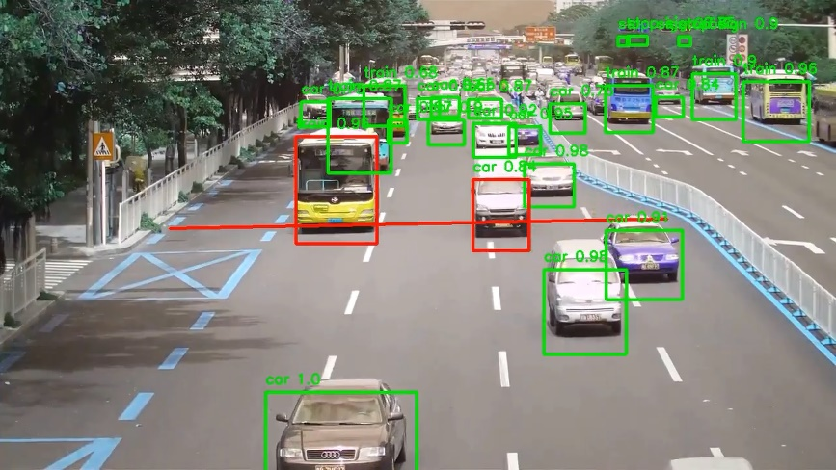
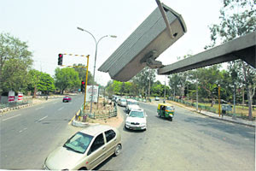
Literature Survey
Dongguan, China
Khulna, Bangladesh
Panchkula, India

Slide 5






Research findings for existing literature
Traffic signal violation using AI/ML
Detect signal jumping, using region of interest, location of vehicle in duration frames.
Average vehicle journey reduced by 12%, traffic throughput increased by 10%
Traffic Violation Detection System based on RFID Creating a system similar to toll plaza, for lane detection, embedding RFID readers on Light Poles. Track Activity in no parking zones/accident prone areas
Deep learning approach for intelligent intrusion system
The paper proposes that, YoloV3 is a good measure to detect vehicle count detection with 97.67% accuracy
Automated Traffic Violation system using genetic algorithm and ANNs
Catching violators swerving or blocking the pedestrian lane with an accuracy of 90.67% with 1.34s runtime
Big data platform of traffic violation detections, identifying the risky behaviors of vehicle drivers
4 Stages, MAPE - Unstructured data collection, knowledge base creation, unsafe driving behavior detection, Storing data in HDFS. As nodes increases from 1 to 7, it becomes 75% more faster.
Traffic Violation detection using multiple trajectories evaluation of vehicles
Image processing is being used to detect lane violation, using mean square displacement method (MSD)

Slide 6
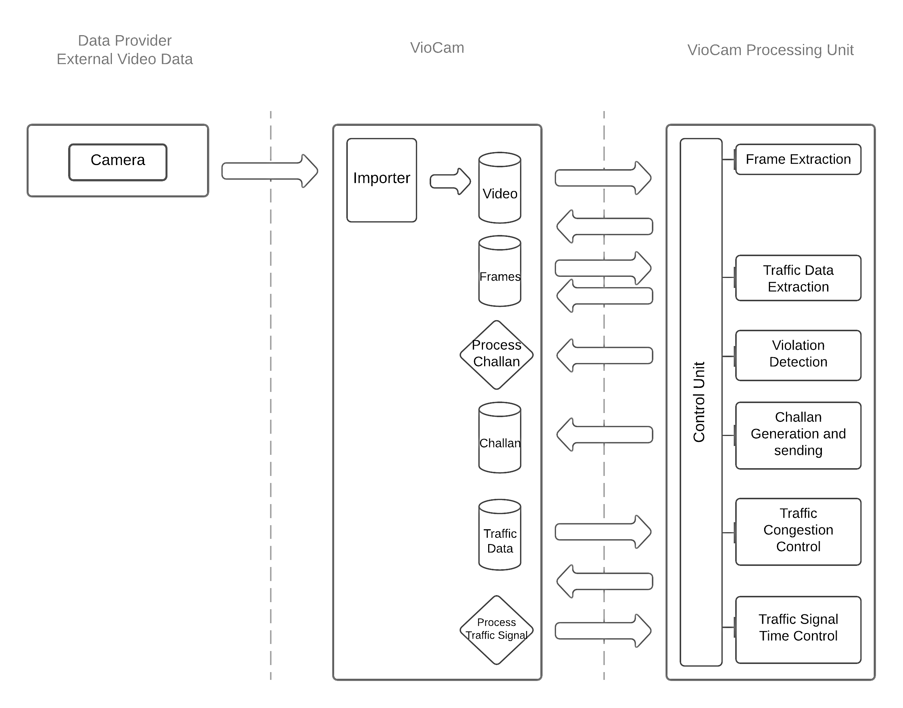
3 Tier Architecture

Slide 7




Tools/Platform Used

Slide 8
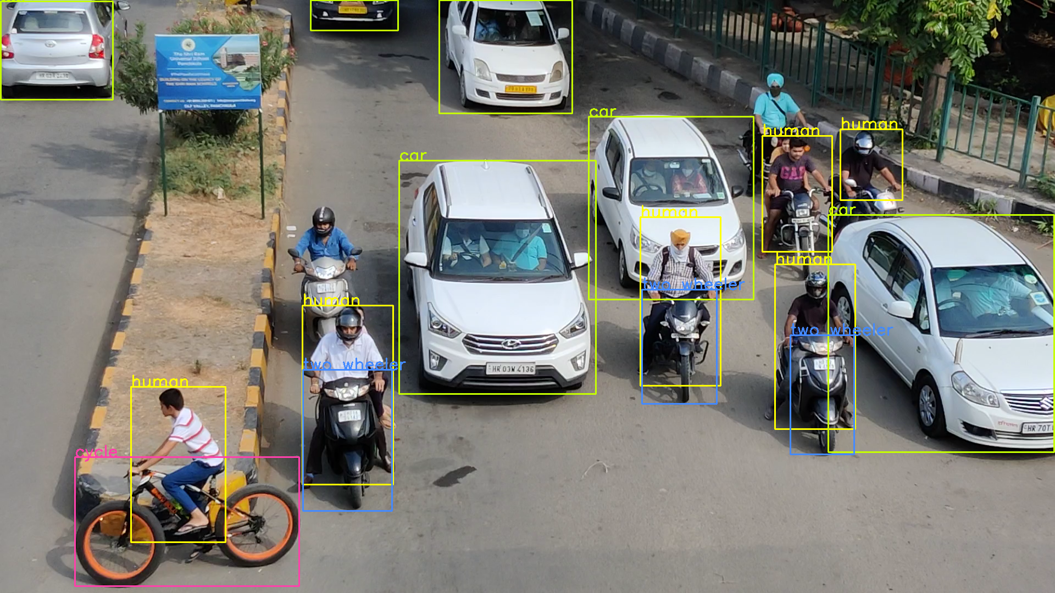
Working of the Project
Vehicle detection, vehicle classification and human detection

Slide 9
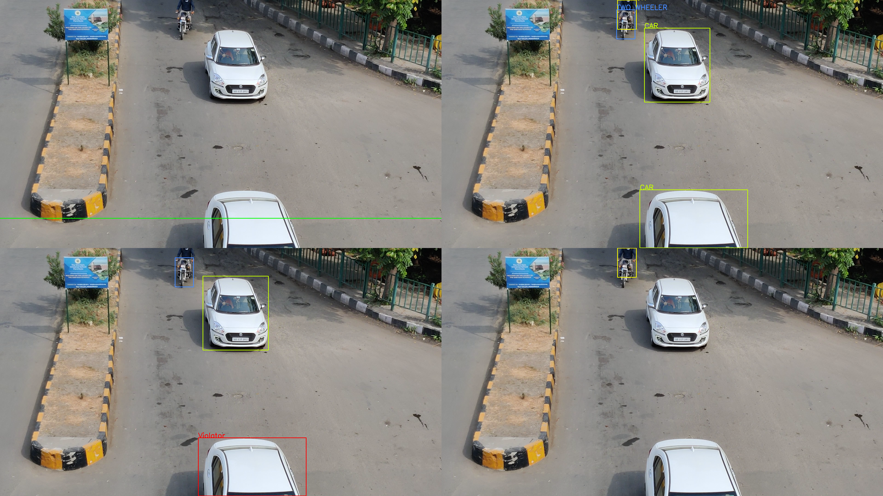
Working of the Project
Violation Detection

Slide 10

Working of the Project
Improving helmet detection

Slide 11
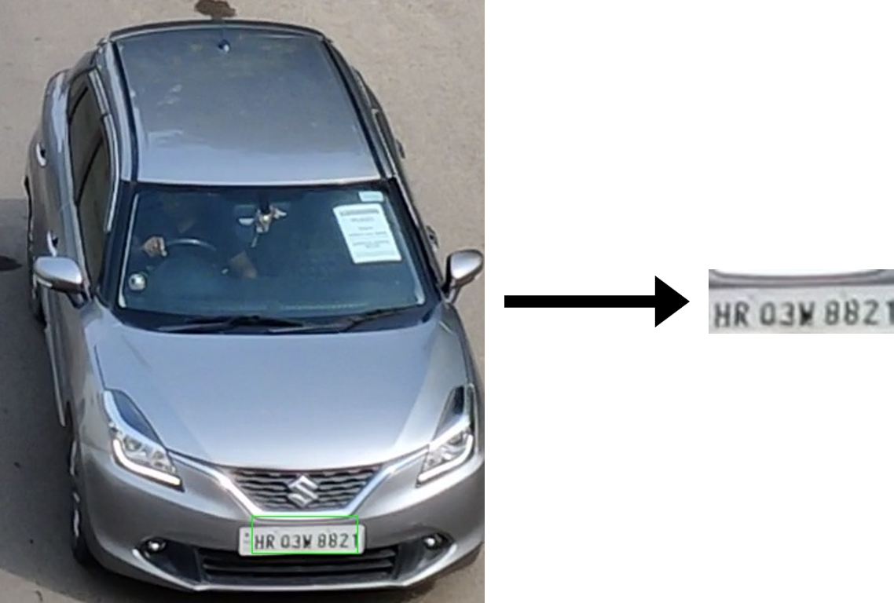
Working of the Project
Number Plate Detection

Slide 12
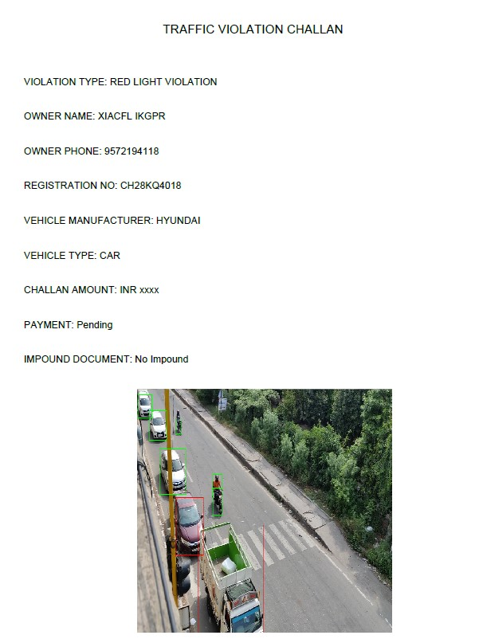
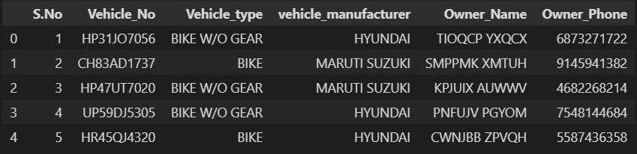
Working of the Project
Dummy Dataset
Generated Challan

Slide 13
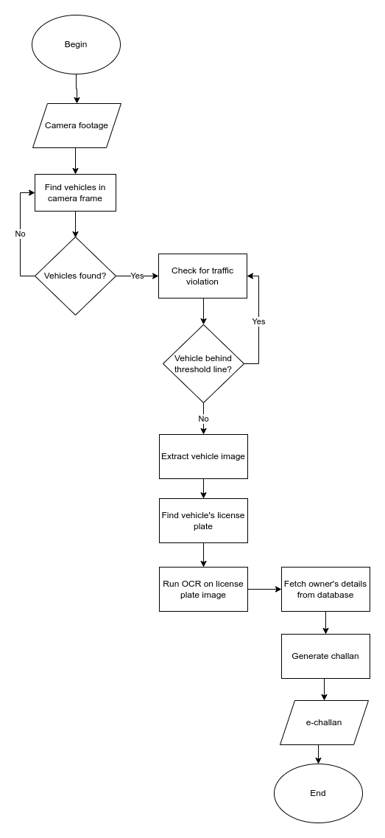
Project Design
----------
Flowchart

Slide 14
Deliverables of the project
An automated traffic management system that can:
Detect traffic violations such as red light jumping and no-helmet riding
Detect the number plate and recognize the characters on the number plate
Automatically generate challan for a violator
Differentiate between vehicle types and check for vehicle type specific violations.

Slide 15
Individual Roles
Aryan Tyagi – Improving Helmet Detection, Training the model on Indian cars, , Optimization, Testing, Documentation
Tushar Kumar Riyat – Implement vehicle classification, Testing, Training the model on Indian cars, Optimization, Documentation
Aditya Singh – Implement vehicle classification, Training the model on Indian cars, Optimization, Documentation

Slide 16
GP - 5
VioCam : Smart Camera for Traffic Violation Detection
101816022 - Aryan Tyagi
101816016 - Tushar Kumar Riyat
101803717 - Aditya Singh
Under the mentorship of
Dr. Seema Wazarkar

